Slide 1

HTML 1
Batch 17 | Bootcamp Frontend Web Devlopment

Slide 2


Frontend Developer
Rizky Ramadhan
at Telkom Indonesia (2021 - present)
Mentor
Tech Content Creator
2022 - present
Frontend Dev @Telkom Indonesia
Tech Content Creator
Frontend Mentor
at dibimbing.id (2022 - present)
LinkedIn:
/in/rizkykyra

Slide 3
Outline
Introduction to HTML
HTML Syntax Structure
Heading
Text Element
Block Elements and Inline Elements
Nested Elements
Hyperlink
HTML Media
HTML semantic
vs non-semantic

Slide 4
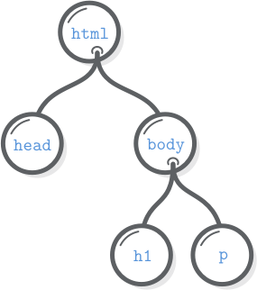


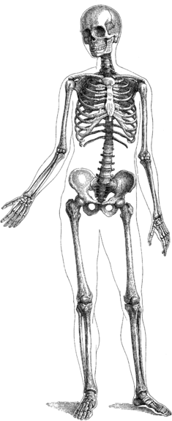


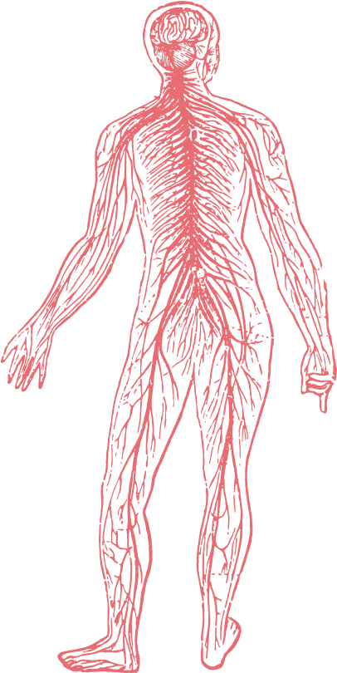



Front-End Development
HTML adds meaning to plain content by using special tags.
CSS is for styling the structured content created with HTML.
JavaScript adds interactivity to the structured content and styling created with HTML and CSS.
HTML the Skeleton
CSS the Human Body
JavaScript the Brain

Slide 5
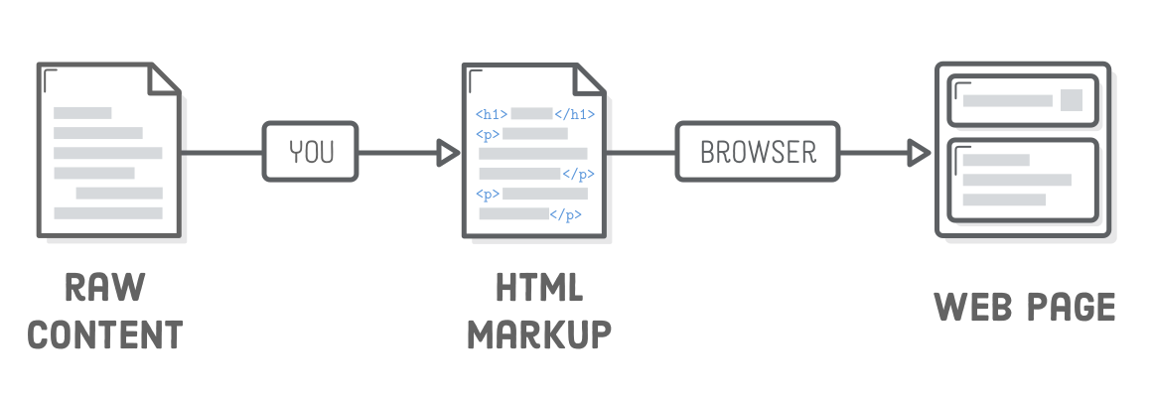
Front-End Development

Slide 6
Intro to HTML
HTML (HyperText Markup Language)
HTML is a markup language that web developers use to structure and
describe the content of a webpage (not a programming language).
HTML consists of elements that describe different types of content:
paragraphs, links, headings, images, video, etc.
Web browsers understand HTML and render HTML code as websites.

Slide 7
HTML
Code Structure
Closing tag: Same as opening tag, but with a /. When element has no content, it’s omitted
Element
<p>What is HyperText Markup Language?</p>
Content: Content of the element, in this example text. But it might be another element (child element). Some elements have no content (e.g. <img>)
Opening tag: Name of the element, wrapped in < and >

Slide 8
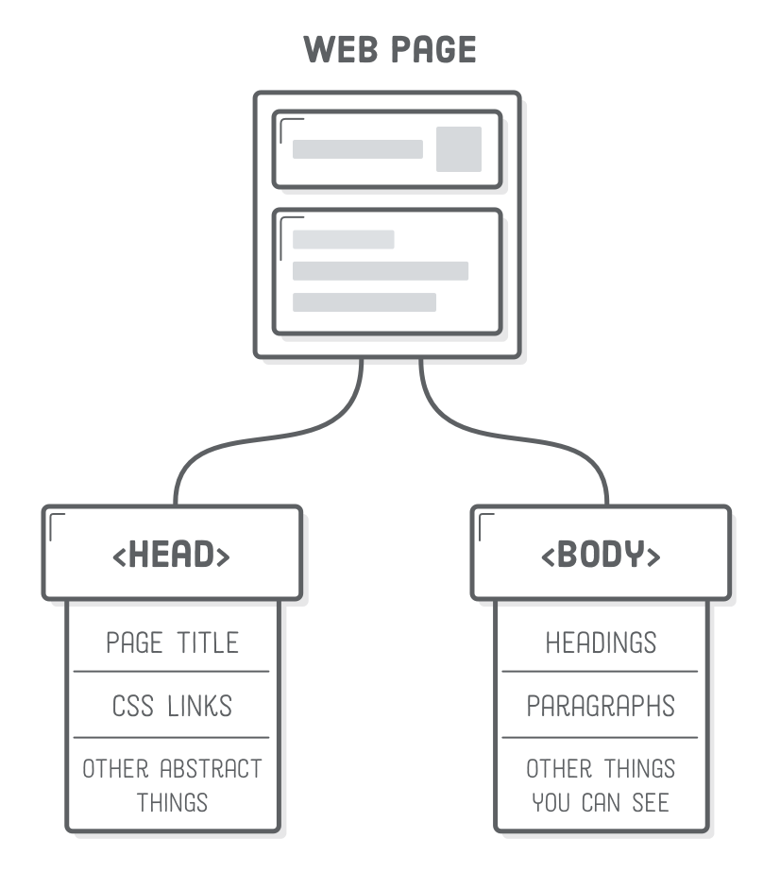
HTML Document Structure

Slide 9
Let’s Code

Slide 10
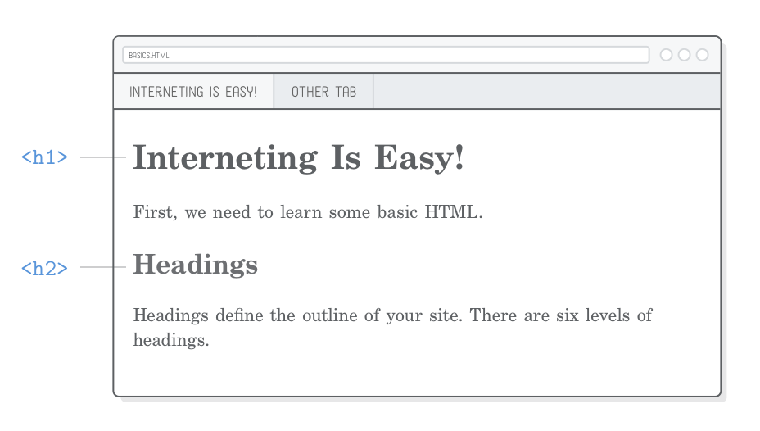
Heading
Headings in HTML are used to define the structure and hierarchy of a document. They play a crucial role in organizing content and providing a clear visual hierarchy for both users and search engines.

Slide 11
Let’s Code

Slide 12
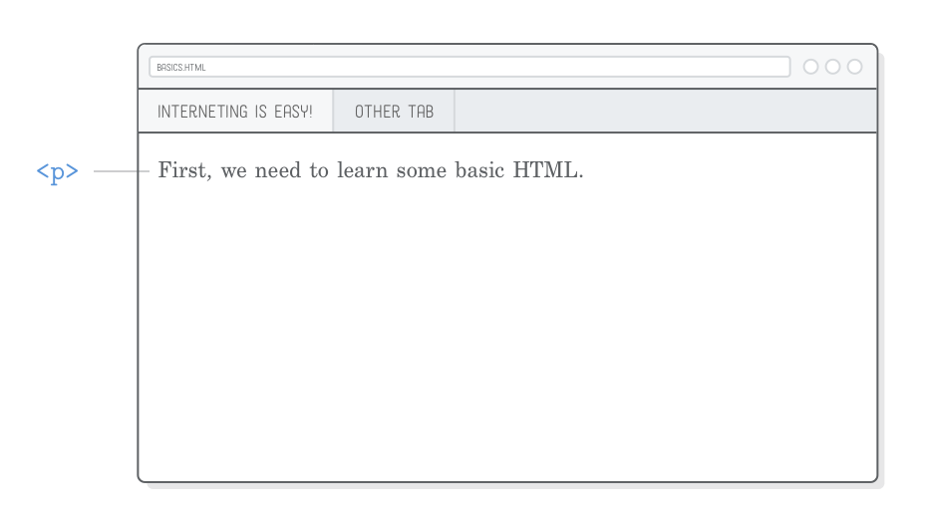
Text Element
Text elements in HTML are used to structure and format textual content within a web page. These elements provide a way to apply various styles, emphasize certain words or phrases, and organize the information for better readability.

Slide 13
Common HTML Elements
<p> (Paragraph): Defines a paragraph of text, providing spacing and structure.
<b> (Bold): Represents bold text, used for visual emphasis.
<i> (Italic): Represents italicized text, adding emphasis or a different style.
<strong> (Strong): Represents text with strong importance, often displayed as bold.
<em> (Emphasis): Represents text with emphasized meaning, typically displayed as italic.
<u> (Underline): Represents underlined text, providing a visual styling.
<s> (Strikethrough): Represents text that is crossed out, indicating a change or deletion.
<mark> (Marked Text): Highlights or marks portions of text for emphasis or attention.
<sub> (Subscript): Represents subscript text, often used for chemical formulas.
<sup> (Superscript): Represents superscript text, used for exponents or footnotes.

Slide 14
Let’s Code

Slide 15
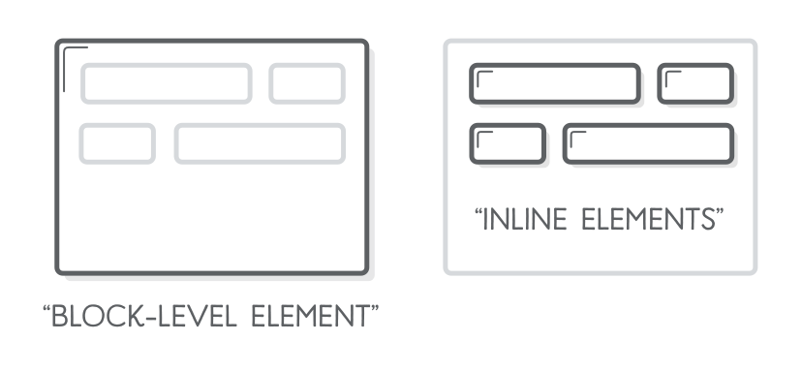
Block and Inline Elements
Block-level elements are always drawn on a new line, while inline elements can affect sections of text anywhere within a line.
For instance, (<p>) is a block-level element, while (<em>) is an inline element that affects a span of text inside of a paragraph. It stands for “emphasis”, and it’s typically displayed as italicized text

Slide 16
Commonly used block elements
<div>: A generic container for grouping and styling content.
Headings (<h1> to <h6>): Define headings of various levels, with <h1> as the highest.
Lists (<ul>, <ol>, <li>): Create unordered lists (<ul>), ordered lists (<ol>), and list items (<li>).
<p>: Represents a paragraph of text.
<table>: Defines a table, including rows (<tr>), columns (<td>), and headers (<th>).

Slide 17
Let’s Code

Slide 18
Ice Breaking

Slide 19
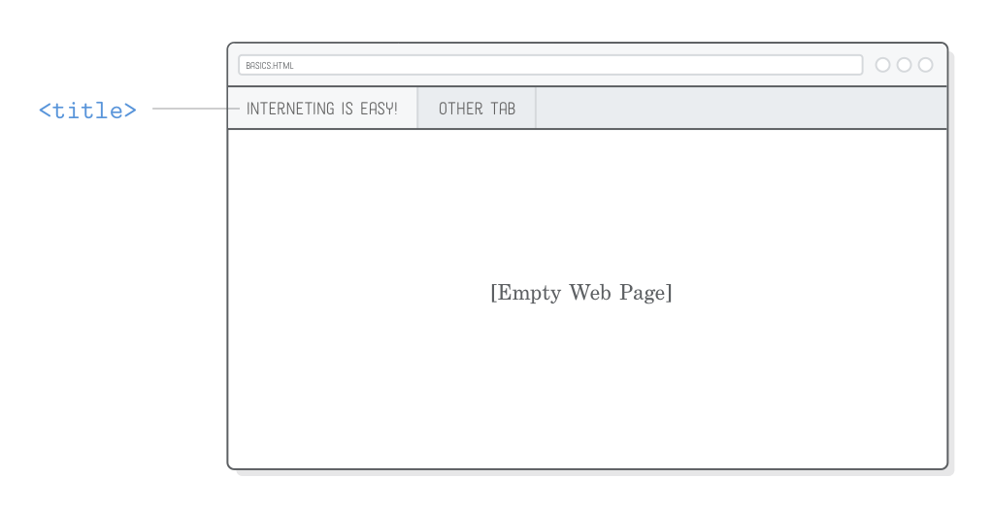
Nested Element
HTML Nested Elements bring structure and order to web documents by allowing elements to be placed within one another. This hierarchical approach enhances organization, enabling the creation of sophisticated layouts and content structures.

Slide 20
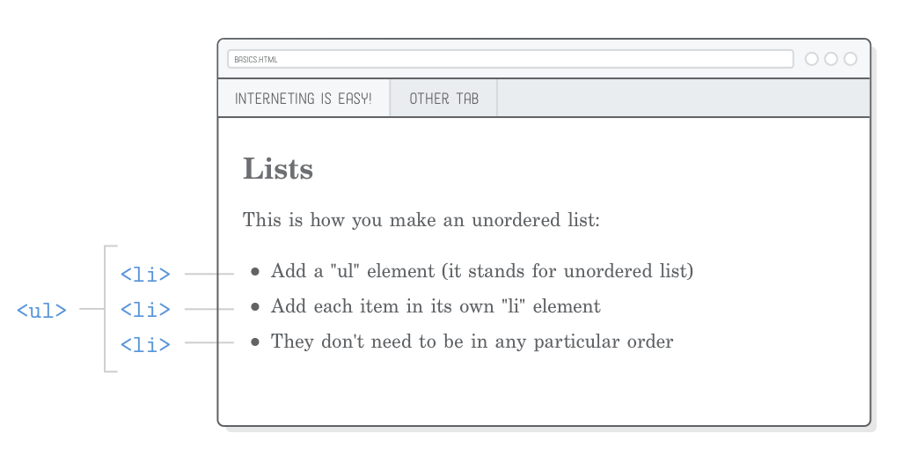
Nested Element: list
HTML lists allow web developers to group a set of related items in lists. There are two different types of lists that are commonly used in HTML.
First is an ordered list starts with the (<ol>) tag. Each list item starts with the (<li>) tag.
Second is an unordered list starts with the (<ul>) tag. Each list item starts with the (<li>) tag.

Slide 21
Let’s Code

Slide 22
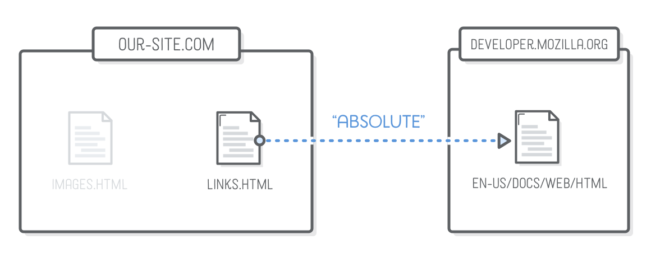
HTML Hyperlink
A basic link is created by wrapping the text or other content inside an (<a>) element and using the href attribute, also known as a Hypertext Reference, or target, that contains the web address.

Slide 23
Let’s Code

Slide 24
HTML Media and Attributes
JPG
GIF
PNG
SVG
HTML Media Elements, encompassing images (<img>), videos (<video>), audio (<audio>), and iframe (<iframe>), play a pivotal role in enriching web content. These elements contribute to a dynamic and interactive user experience, providing versatility in multimedia integration.

Slide 25
Let’s Code

Slide 26
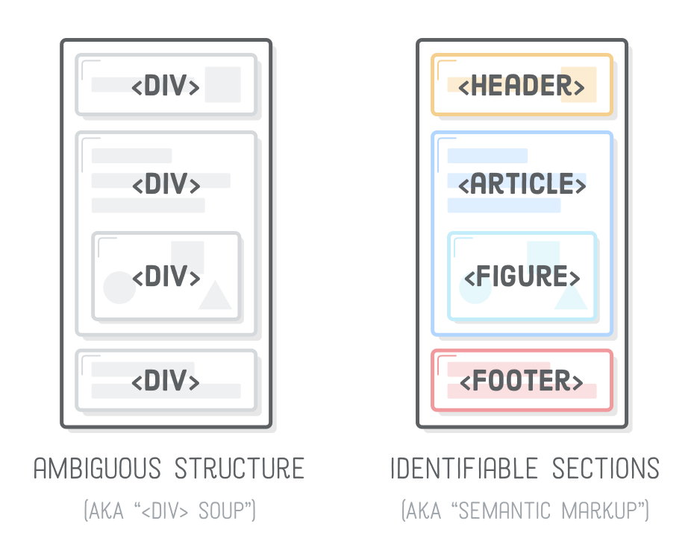
Semantic vs non semantic

Slide 27
Terima
Kasih.
Let’s discuss! ======================= reference: developer.mozilla.org

